Slide 1




PROJECT
ANALYTICS
Expense detail for 6 months & June

Slide 2
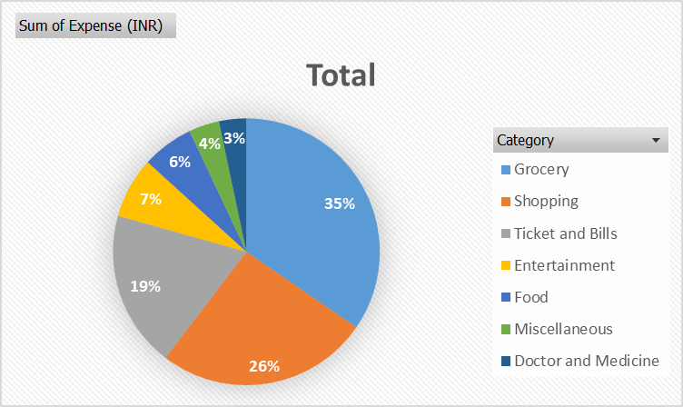
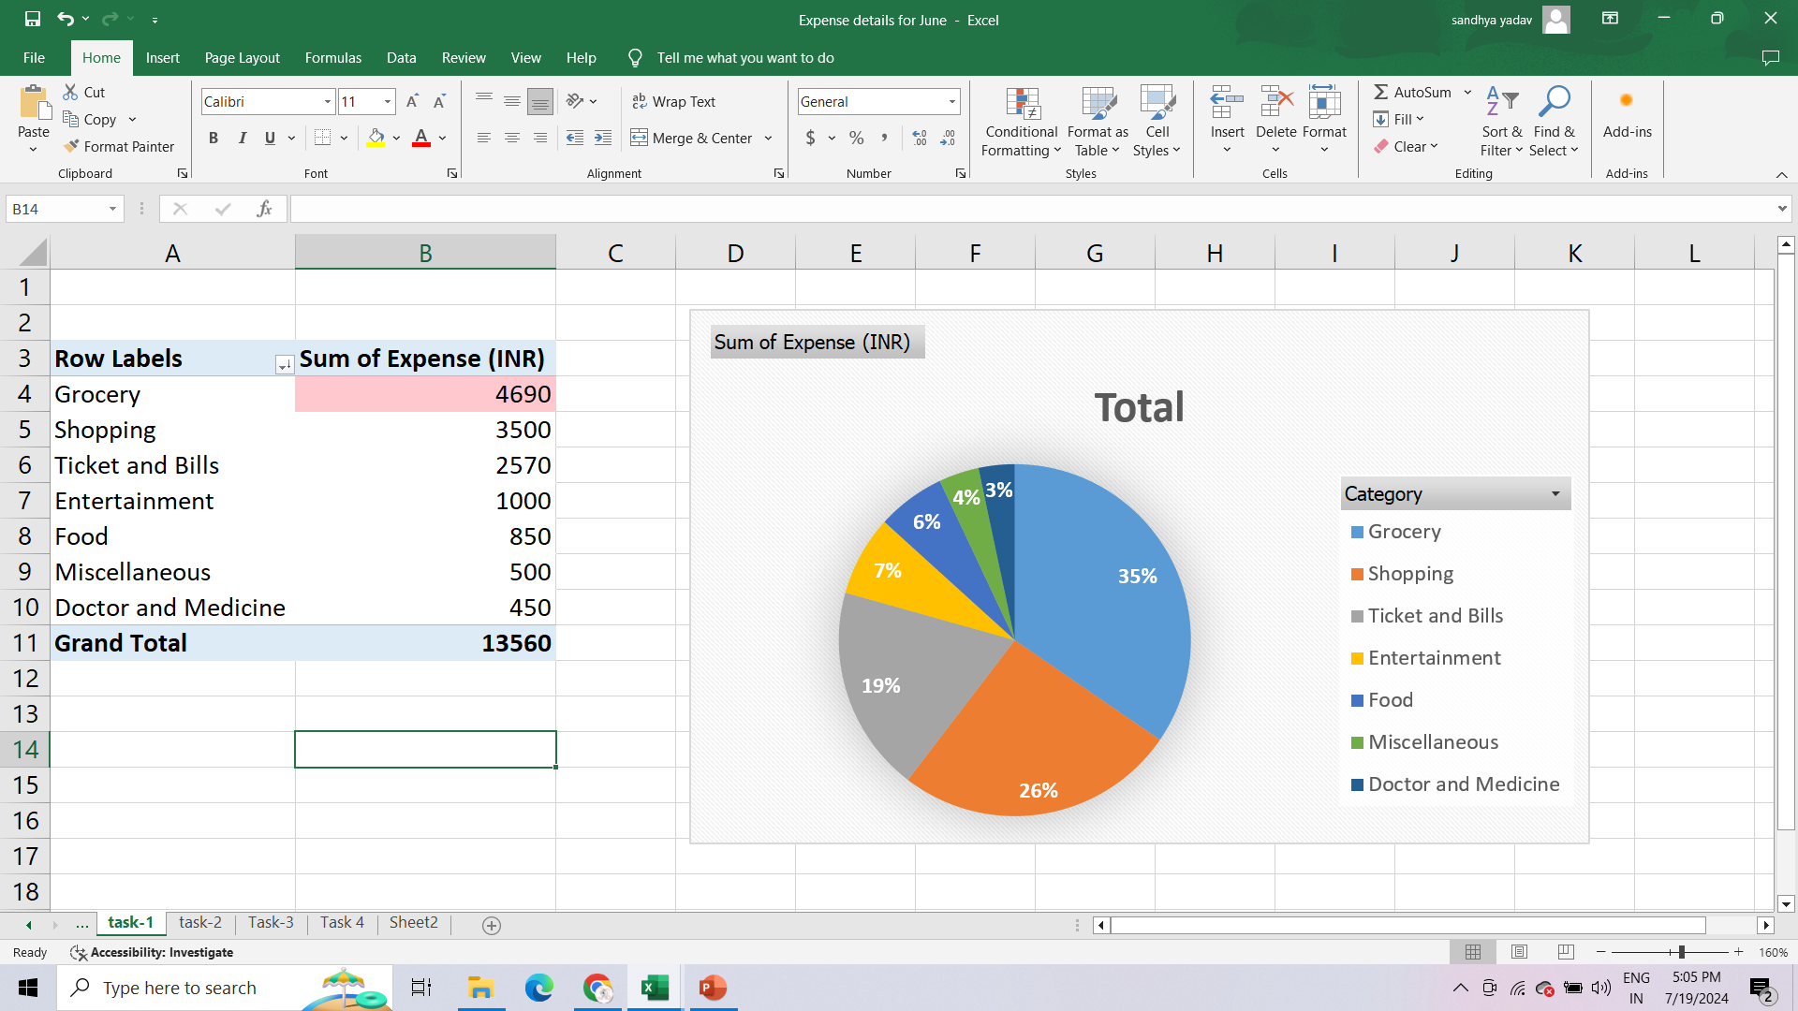
Project 1 - Part One
THE CATEGORY WITH THE HIGHEST EXPENSE AMOUNT.

Slide 3
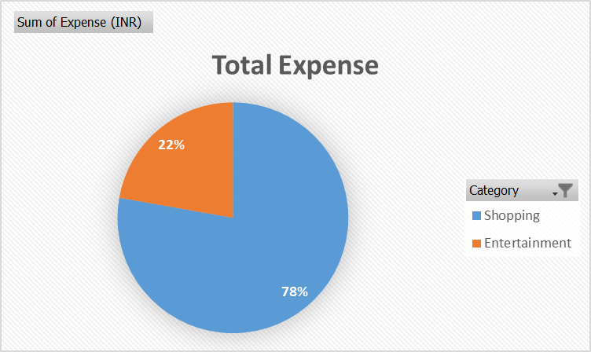
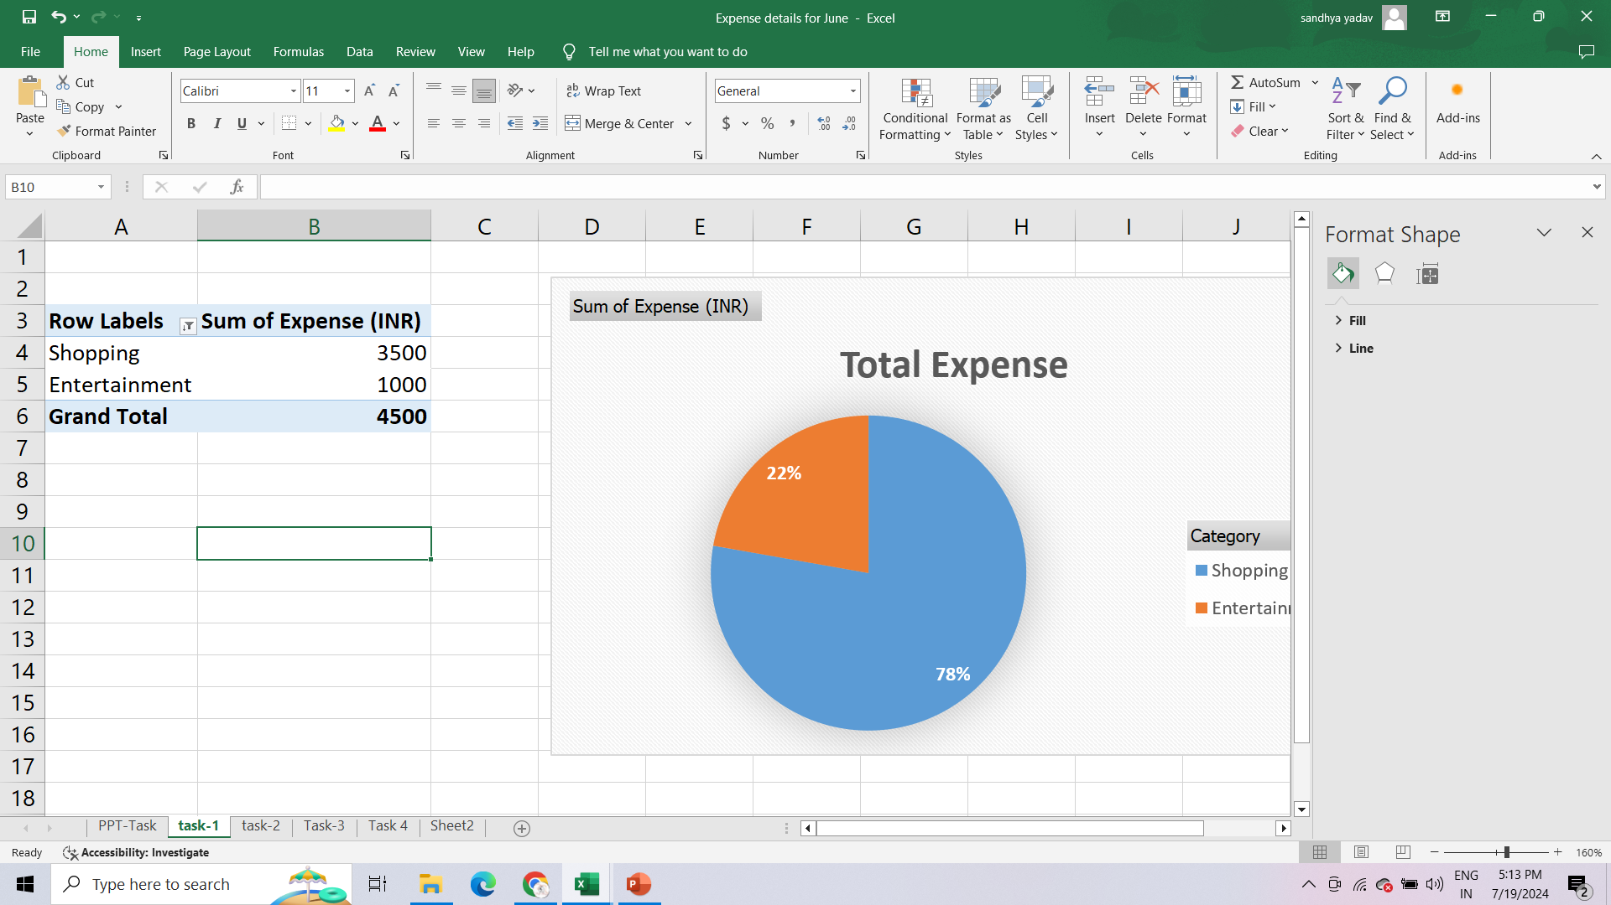
Project 1 - Part One
2. TOTAL EXPENSE AMOUNT AGAINST ENTERTAINMENT AND SHOPPING.

Slide 4
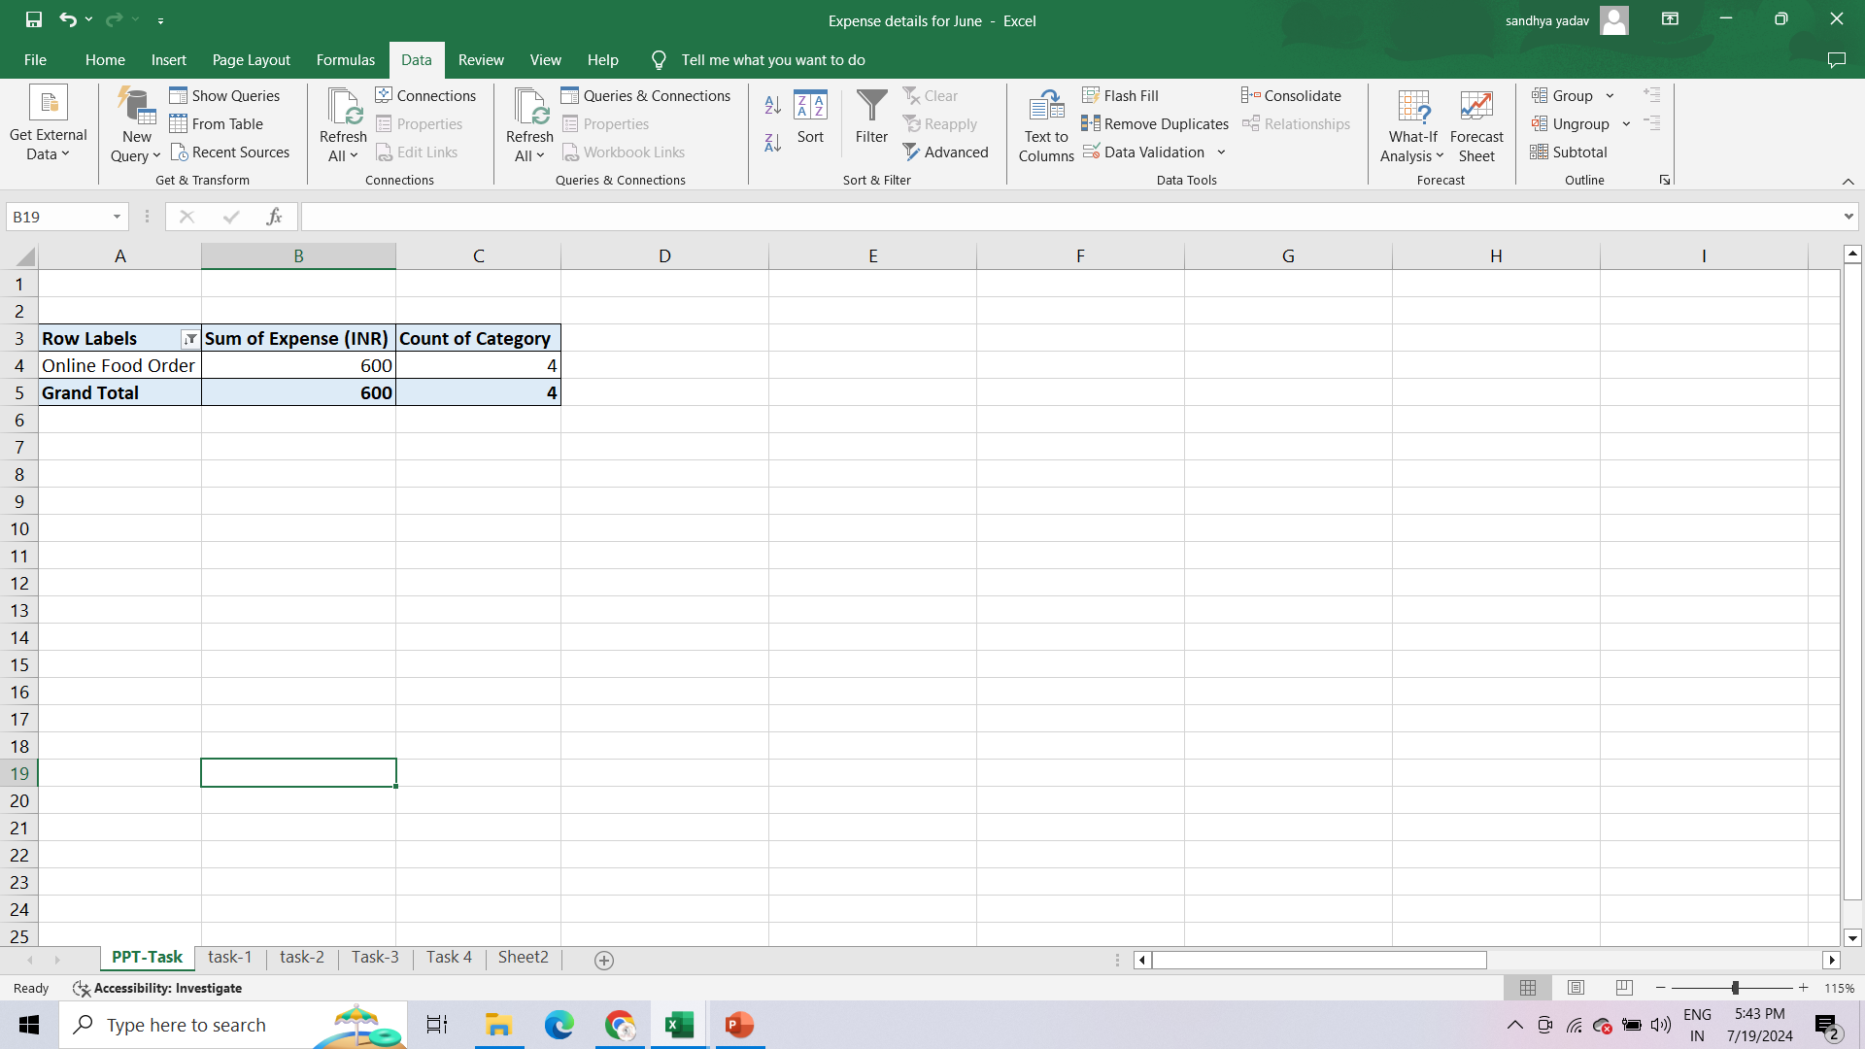
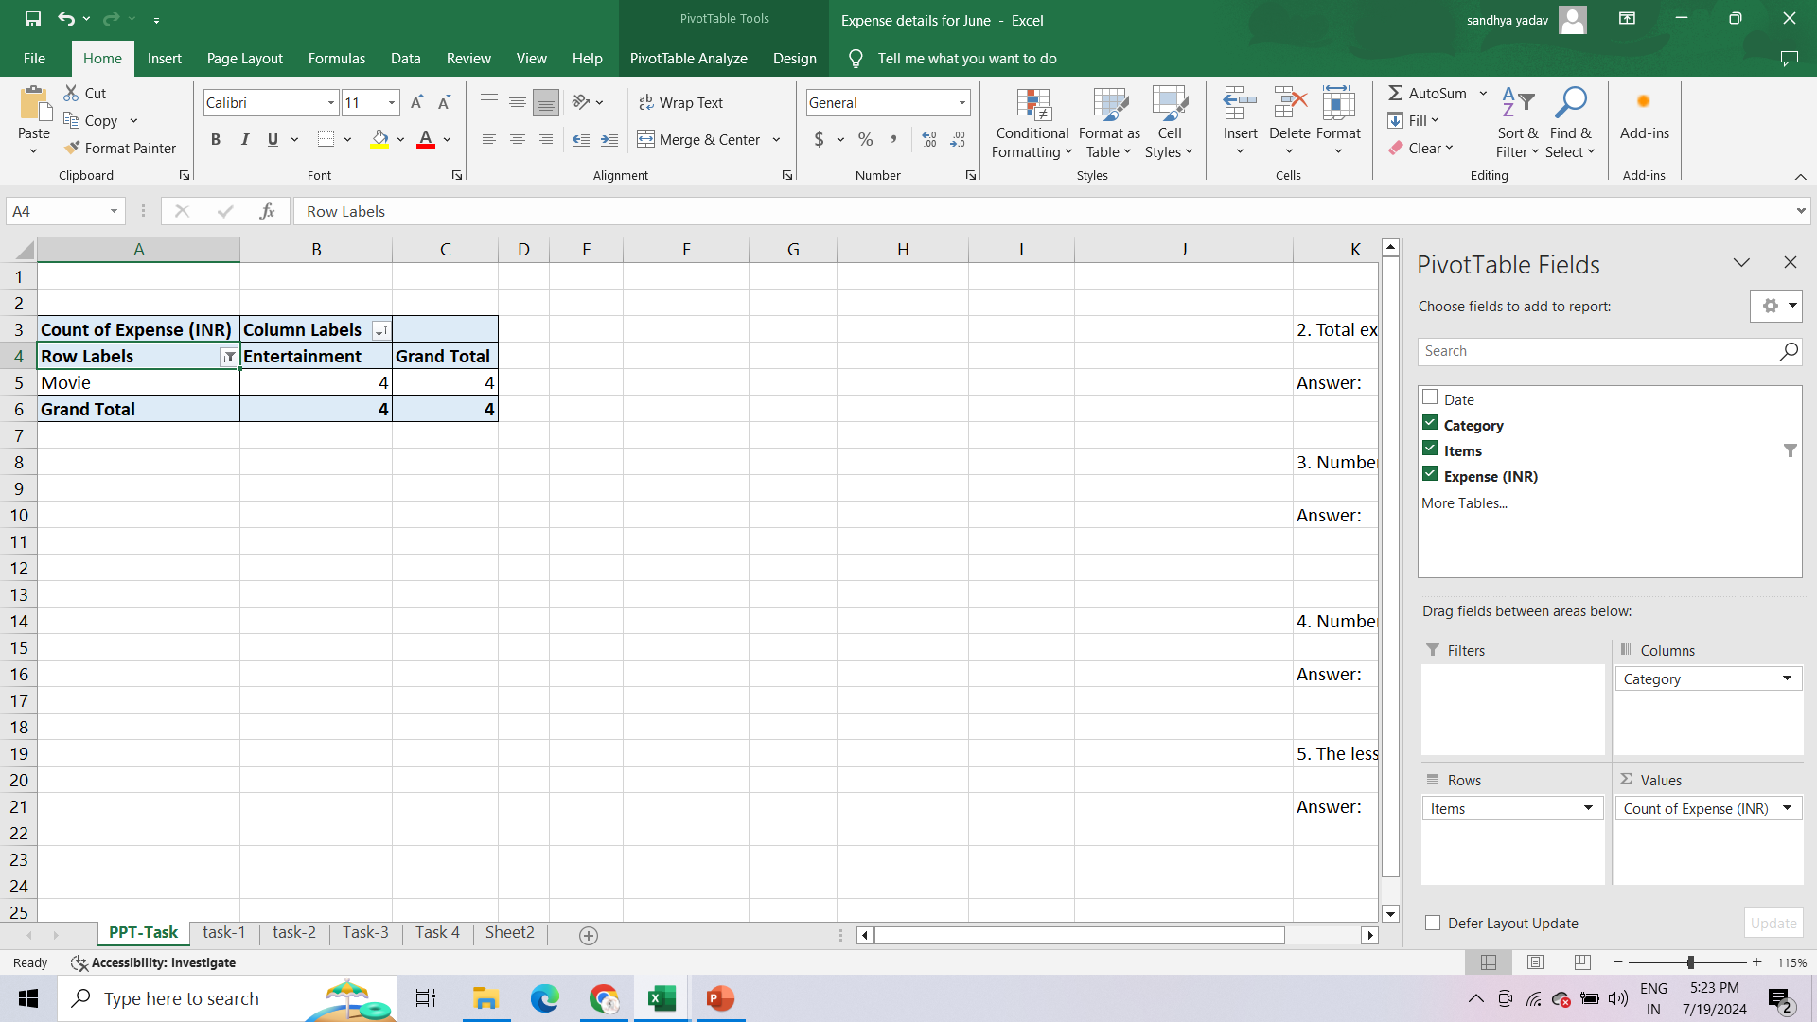
Project 1 - Part One
3. NUMBER OF TIMES NITIN HAS ORDERED FOOD ONLINE AND THE AMOUNT SPENT FOR IT.
4. NUMBER OF TIMES NITIN HAS WATCHED A MOVIE.

Slide 5
Project 1 - Part One
5. THE LESS ESSENTIAL CATEGORY THAT NITIN MAY REMOVE TO INCREASE HIS SAVINGS
ANSWER
Through Analyzing and using Data Validation we can say that Nitin Can remove Entertainment, Miscellaneous and Shopping Category.
He can also, cut down Online food ordering in order to save and buy a scooter.
Using his past, months expense sheet example june month he can optimize and can set a specific amount to utilize on specific category.

Slide 6
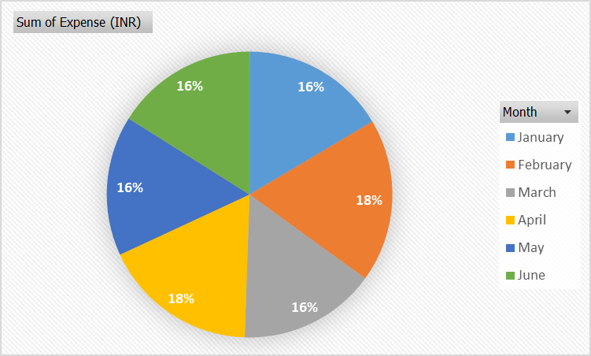
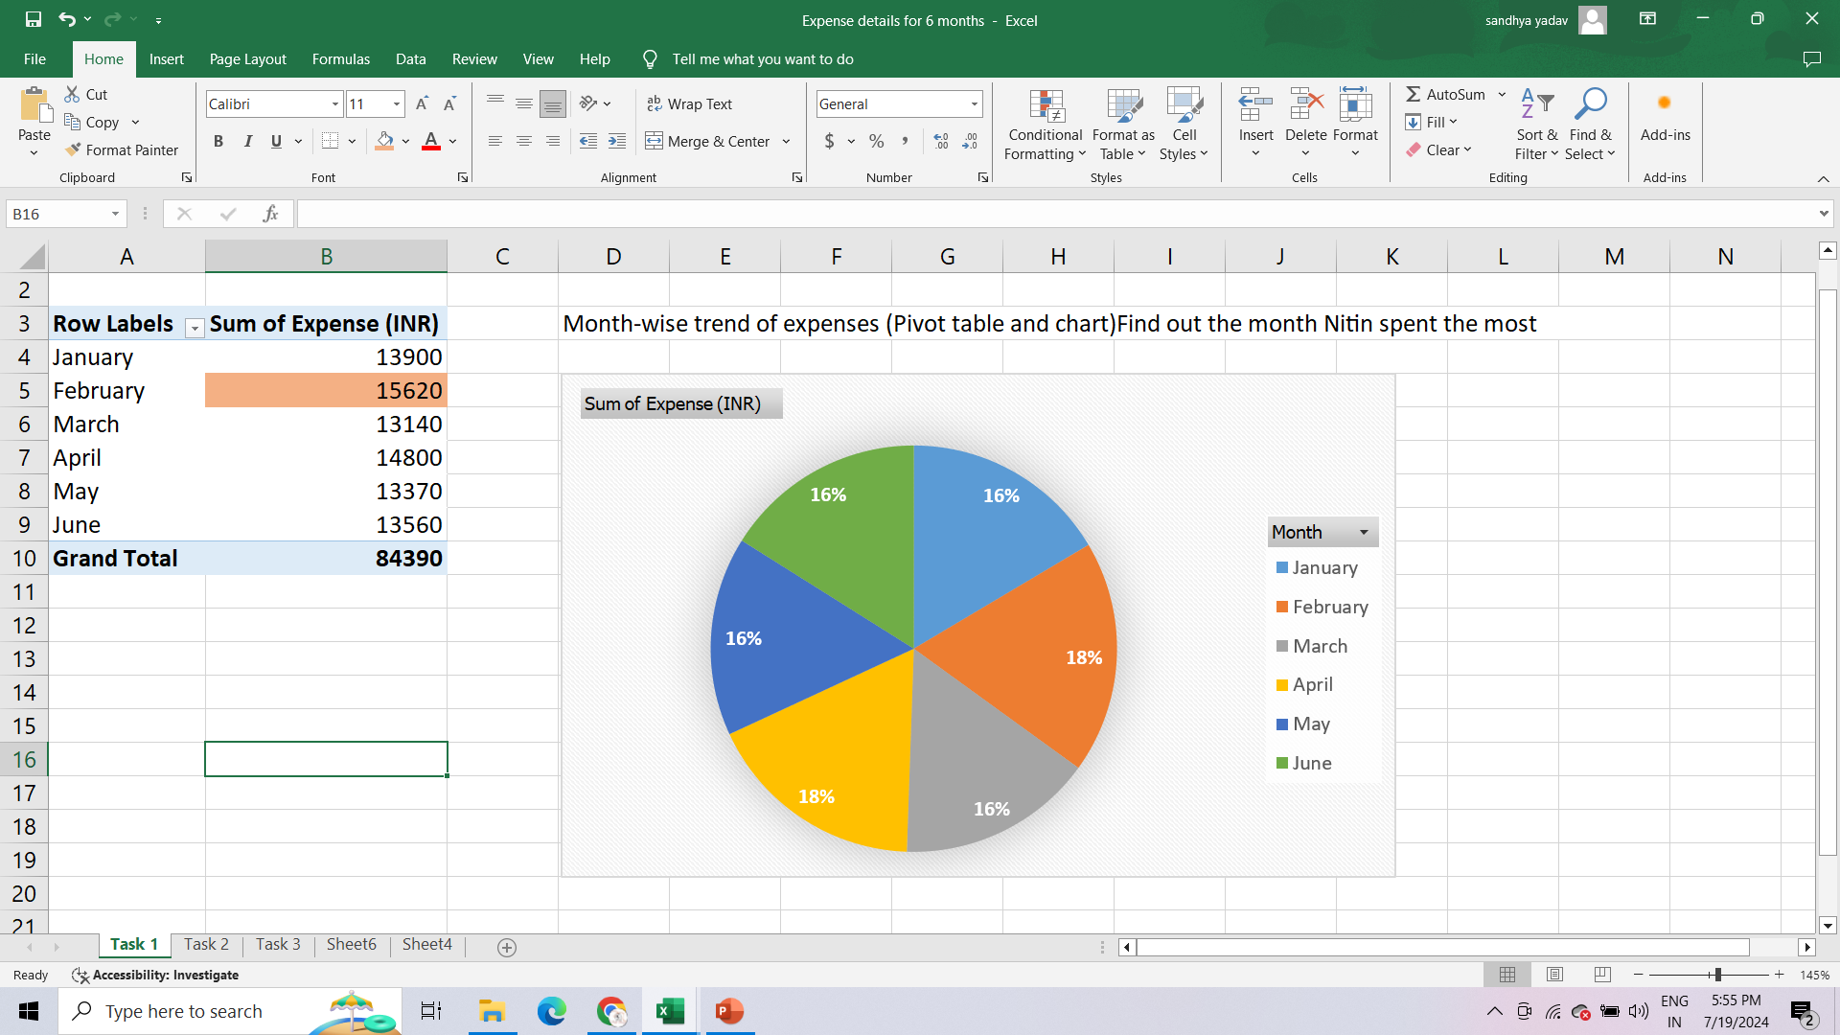
Project 1 - Part Two
THE MONTH-WISE TREND OF EXPENSES AND FIND OUT THE MONTH NITIN SPENT THE MOST.

Slide 7
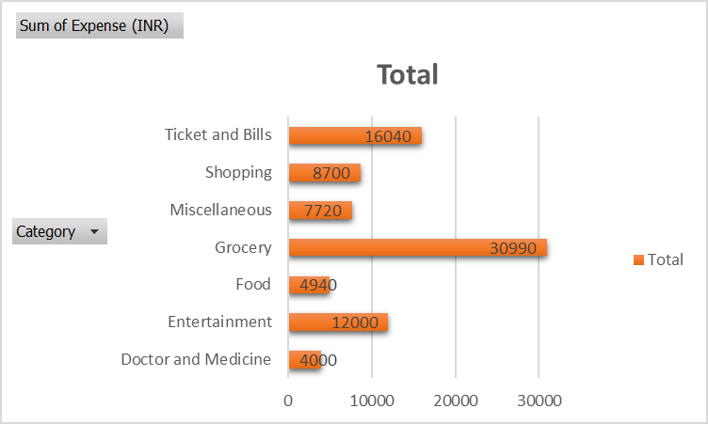
Project 1 - Part Two
2. VISUAL REPRESENTATION OF EXPENSES AGAINST DIFFERENT CATEGORIES.

Slide 8
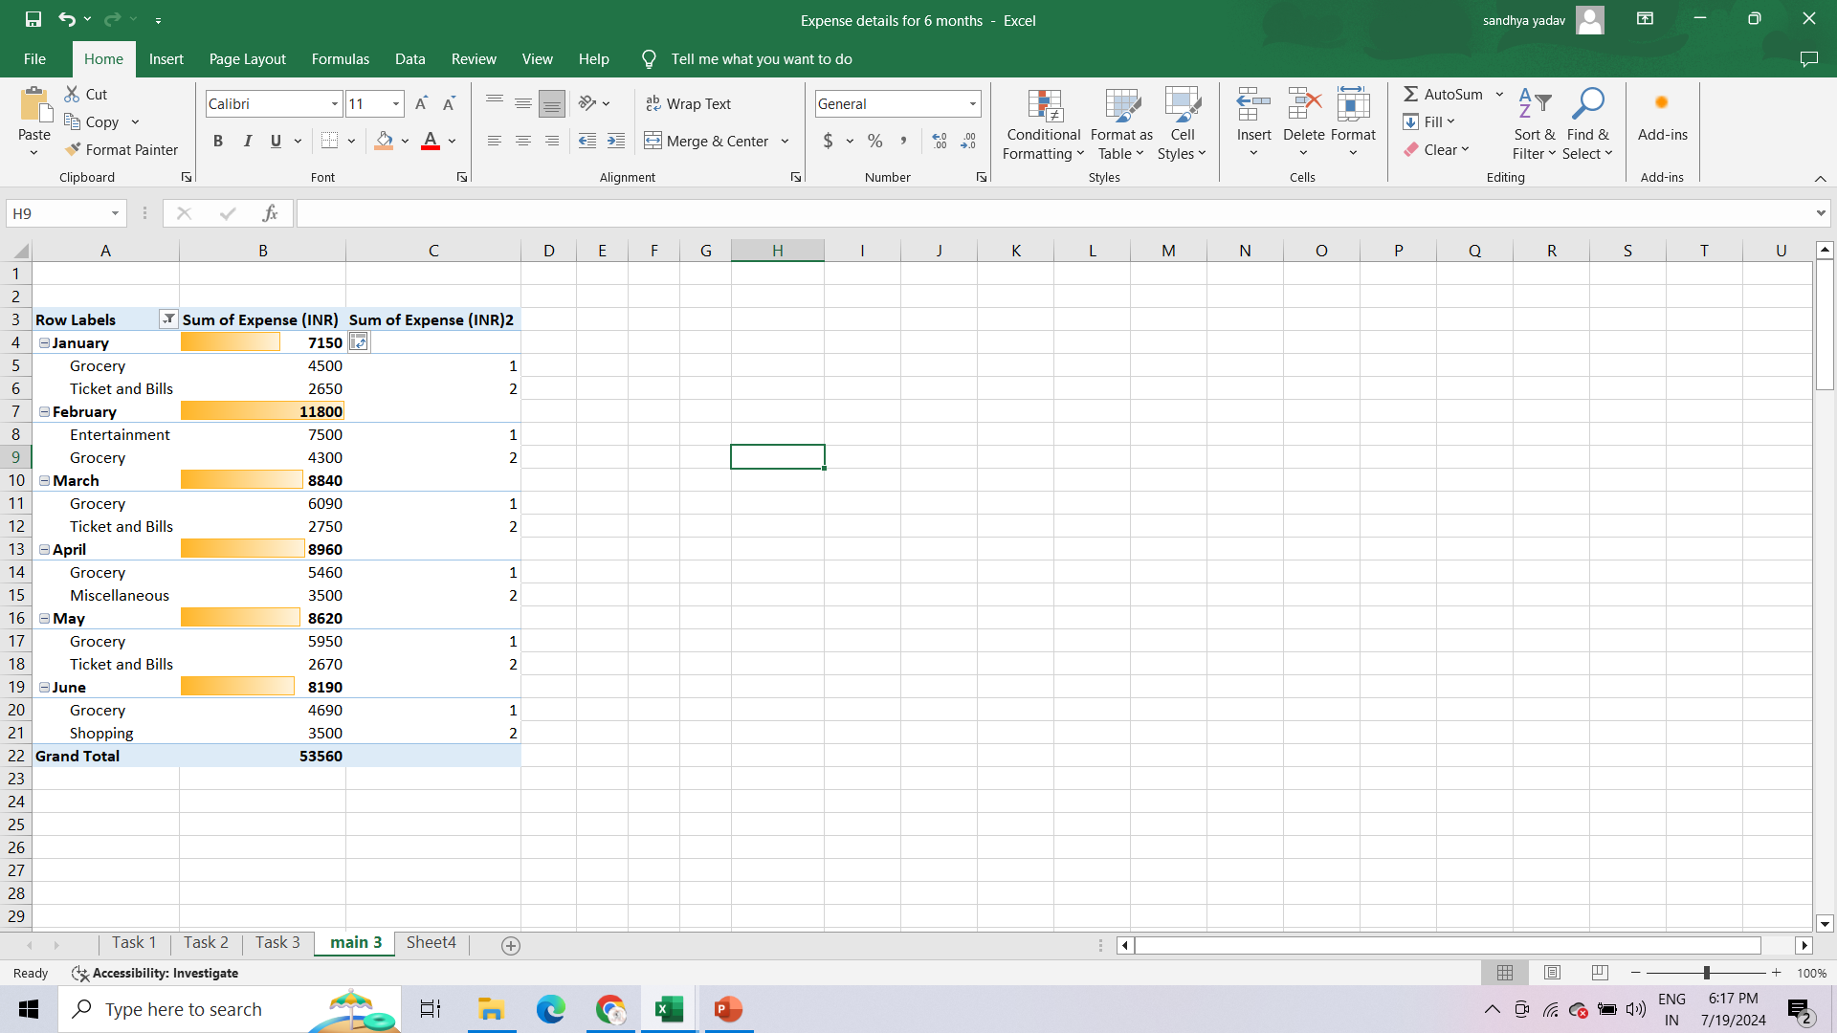
Project 1 - Part Two
3. TOP 2 CATEGORIES WITH HIGHER EXPENSES FOR EACH MONTH.

Slide 9
Project 1 - Part Two
4. RECOMMENDATIONS ON HOW CAN NITIN INCREASE HIS SAVINGS
ANSWER
As, Nitin has Data of his past expenses for six months, he can study and analyze where he spent more amount.
I have observed that he can cut down Shopping, online food ordering from food category and Entertainment.
He can also, minimize the grocery for example he can reduce items like snacks, chips and fries.
Nitin can make tentative expense sheet for upcoming months by taking consideration of saving.

Slide 10
THANK YOU
By Sapna Yadav

